Slide 1





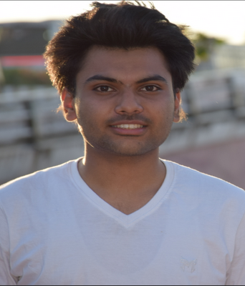
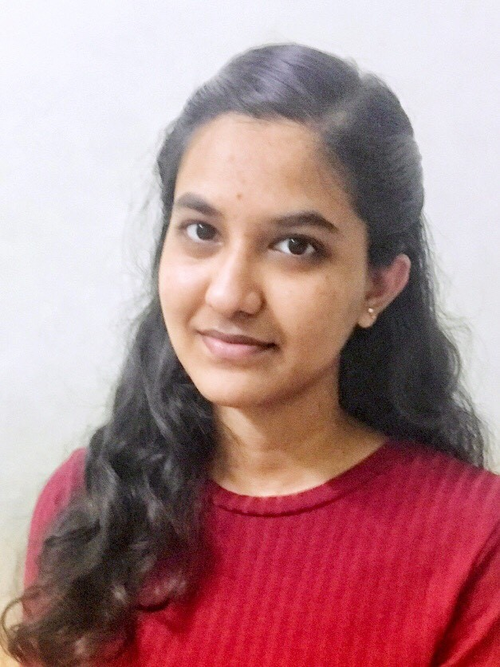
Getting Started with Image Classification using Azure ML
Arsalan Anwar
Associate Data Scientist
West Pharmaceutical Services
Niranjana Reddy J
Associate Data Scientist
West Pharmaceutical Services

Slide 2

Agenda
Brief Overview of Azure ML
Image Classification using AML Designer
Demo
Leveraging AML for Offline trained models

Slide 3

Overview of Azure ML

Slide 4
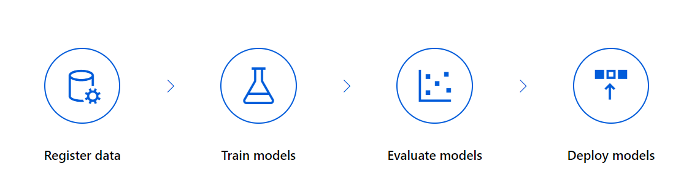
What is Azure ML?
Azure Machine Learning is a cloud-based environment that can be used to train, deploy, automate, manage, and track ML models.

Slide 5
Why Azure ML?
Challenges faced by Data Scientists
Advantages of Azure ML
Multiple data sources
Lot of time taken for end to end implementation
No proper infrastructure
Integration with various other services
Code first or no code experience
Multiple data sources can be integrated
End to end implementation, from training to deployment, can be done in a short span of time.
Provides powerful infrastructure like CPU and GPU which will accelerate the learning process.
Integration of various Azure Services like AKS, DataBricks, DataLake Analytics, MLOps, etc

Slide 6
Image Classification using Azure ML

Slide 7
Image Classification using Azure ML
Azure ML provides easy to use modules for Image classification capabilities like:
Data Labelling
Image Transformation
Image Augmentation
Powerful model architectures like DenseNet and ResNet.
Custom Models and Scripts
Performance Evaluation
It provides intuitive interface for creating pipelines, deploying it as a REST API endpoint and testing it.

Slide 8
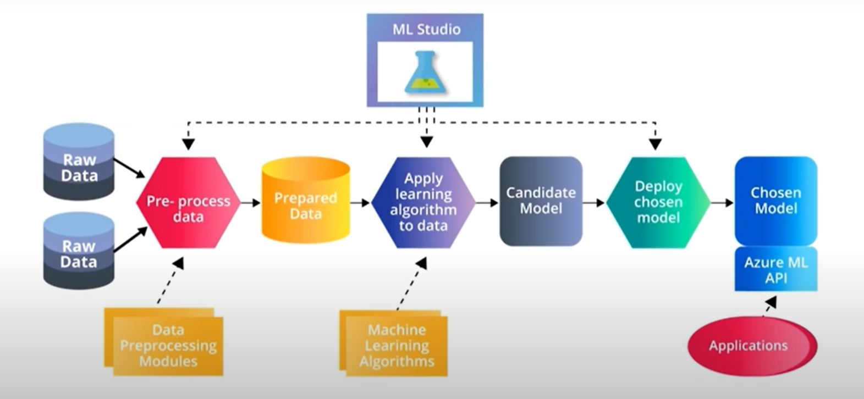
End to End AML Flow

Slide 9

Demo

Slide 10

Leveraging AML for Offline Trained Models

Slide 11
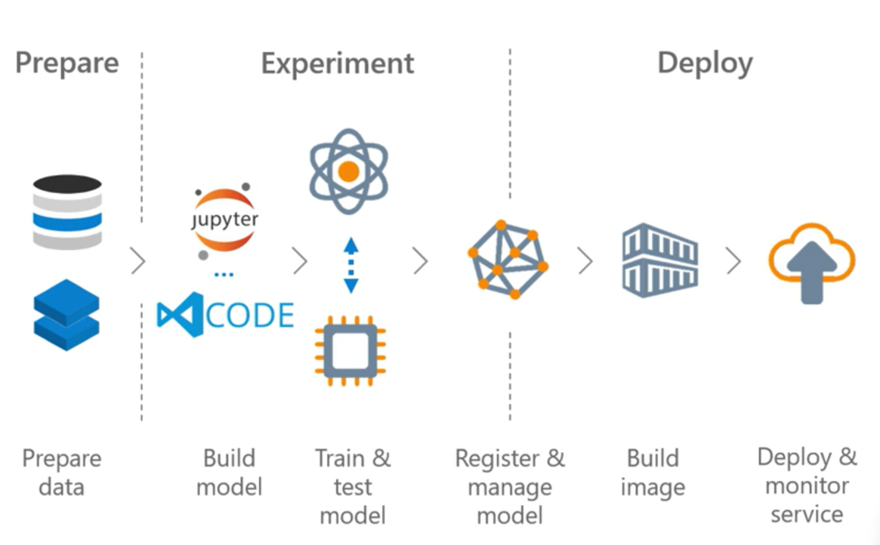
Leveraging AML for Offline Trained Models

Slide 12

Summary

Slide 13
Summary
In this session, we have covered the following:
Brief Overview of Azure ML
What is Azure ML?
Why Azure ML?
Image Classification using AML Designer
End to End Flow
Demo
Leveraging AML for Offline trained models

Slide 14



Questions?
For further queries:
Arsalan Anwar
Niranjana Reddy J
arsalan.anwar.7777@gmail.com
https://www.linkedin.com/in/arsalananwar1998/
j.niranjana.reddy@gmail.com
https://www.linkedin.com/in/niranjana5

